Slide 1

Strategic Management - Business models
Daniel Wisniewski, PhD MBA

Slide 2

What is a Business Model?

Slide 3
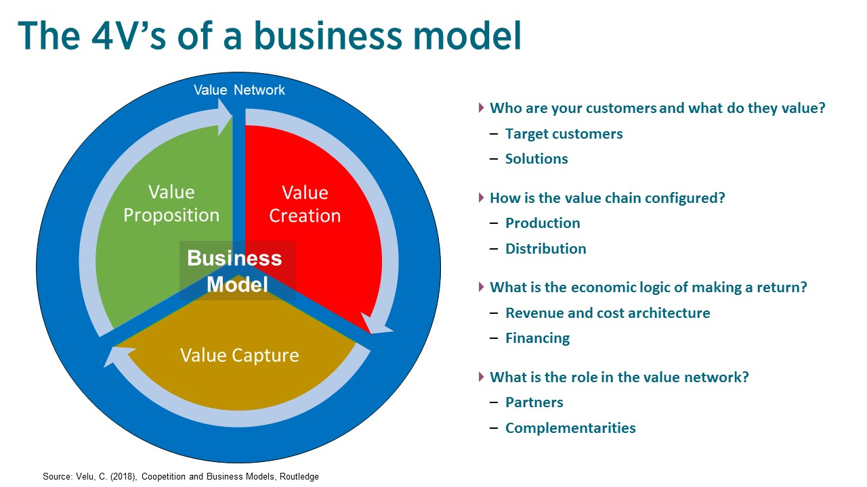

Slide 4
Business models serve as strategic options for firms by providing a structured approach to generating value, capturing revenue, and delivering products or services to customers. Here are some common business models that firms can consider as strategic options

Slide 5
E-commerce Model: In this model, businesses conduct transactions online, selling products or services directly to customers through a digital platform. Examples include online retailing (e.g., Amazon), online marketplaces (e.g., eBay), and subscription-based services (e.g., Netflix).

Slide 6
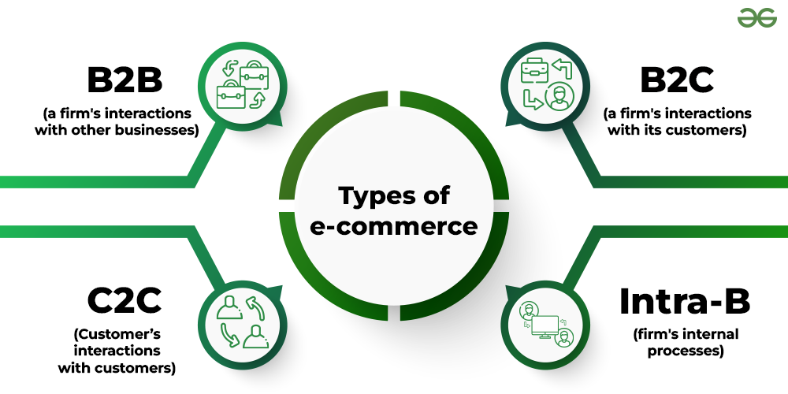
Types of E-Commerce

Slide 7
Subscription Model: Under this model, customers pay a recurring fee for access to products or services over a specified period. This model often offers convenience and predictability for both customers and businesses. Examples include subscription boxes (e.g., Birchbox), streaming services (e.g., Spotify), and software-as-a-service (SaaS) platforms (e.g., Salesforce).

Slide 8
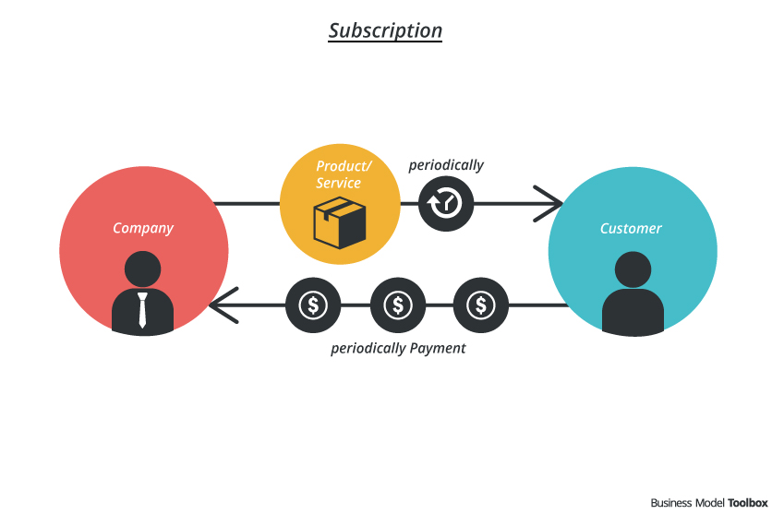

Slide 9
Freemium Model: This model offers a basic version of a product or service for free, while charging for premium features or additional functionality. It allows businesses to attract a large user base with a free offering and monetize a subset of users who are willing to pay for enhanced features. Examples include software applications (e.g., Dropbox), mobile apps (e.g., Spotify), and online gaming platforms (e.g., Fortnite).

Slide 10
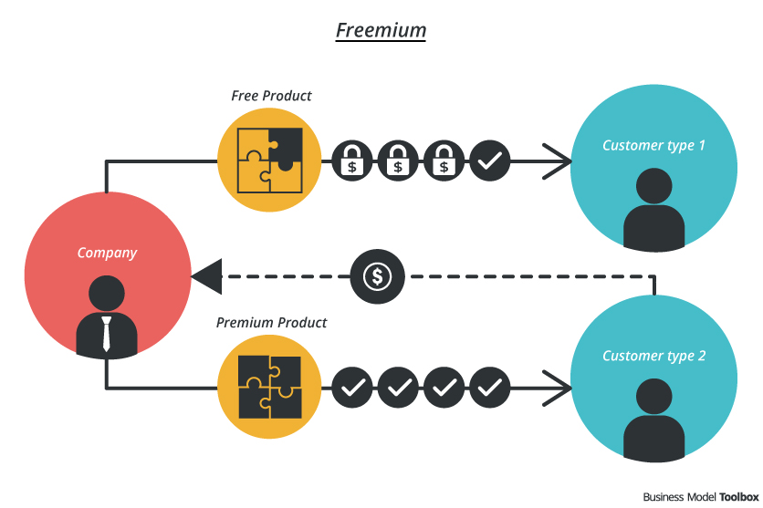

Slide 11
Marketplace Model: In this model, businesses facilitate transactions between buyers and sellers, earning revenue through transaction fees, commissions, or advertising. Marketplaces provide a platform for sellers to reach a larger audience and for buyers to access a wide range of products or services. Examples include e-commerce marketplaces (e.g., Etsy), peer-to-peer lending platforms (e.g., LendingClub), and gig economy platforms (e.g., Uber).

Slide 12
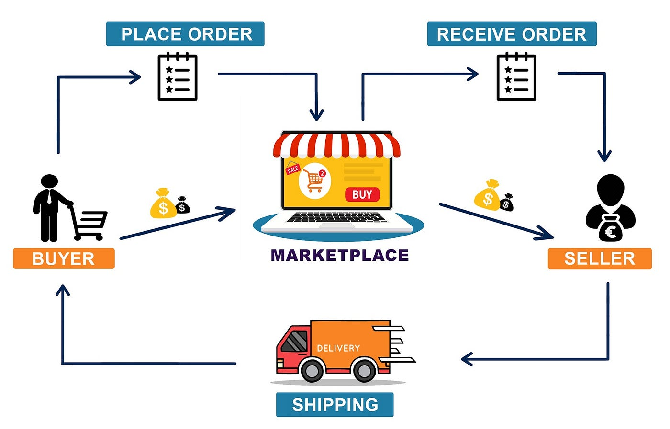

Slide 13
Platform Model: Platforms create value by connecting multiple parties and facilitating interactions or transactions between them. They often leverage network effects, where the value of the platform increases as more users join or participate. Examples include social media platforms (e.g., Facebook), online marketplaces (e.g., Airbnb), and app stores (e.g., Apple App Store, Google Play).

Slide 14
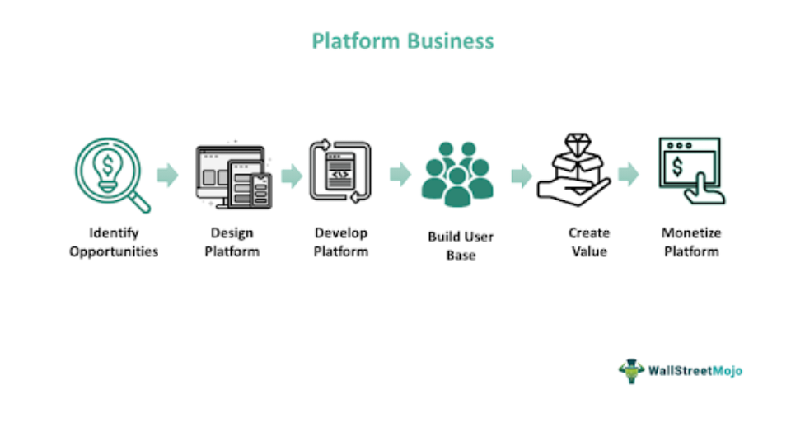

Slide 15
Brick-and-Mortar Model: This traditional model involves physical stores or locations where businesses sell products or services directly to customers. While brick-and-mortar businesses face challenges from e-commerce, they can differentiate through personalized customer experiences, immediate gratification, and face-to-face interactions. Examples include retail stores, restaurants, and service businesses like salons and gyms.

Slide 16
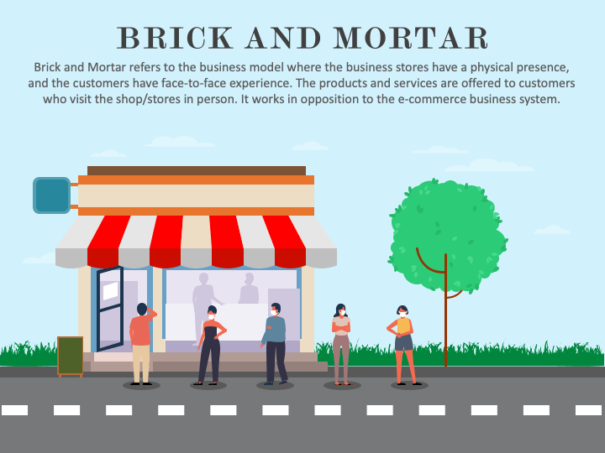

Slide 17
Franchise Model: Franchising allows businesses to expand rapidly by granting individuals or entities the right to operate under the company's brand and business model in exchange for fees or royalties. Franchisees benefit from established brand recognition and support from the franchisor. Examples include fast-food chains (e.g., McDonald's), hotel chains (e.g., Marriott), and retail outlets (e.g., Subway).

Slide 18
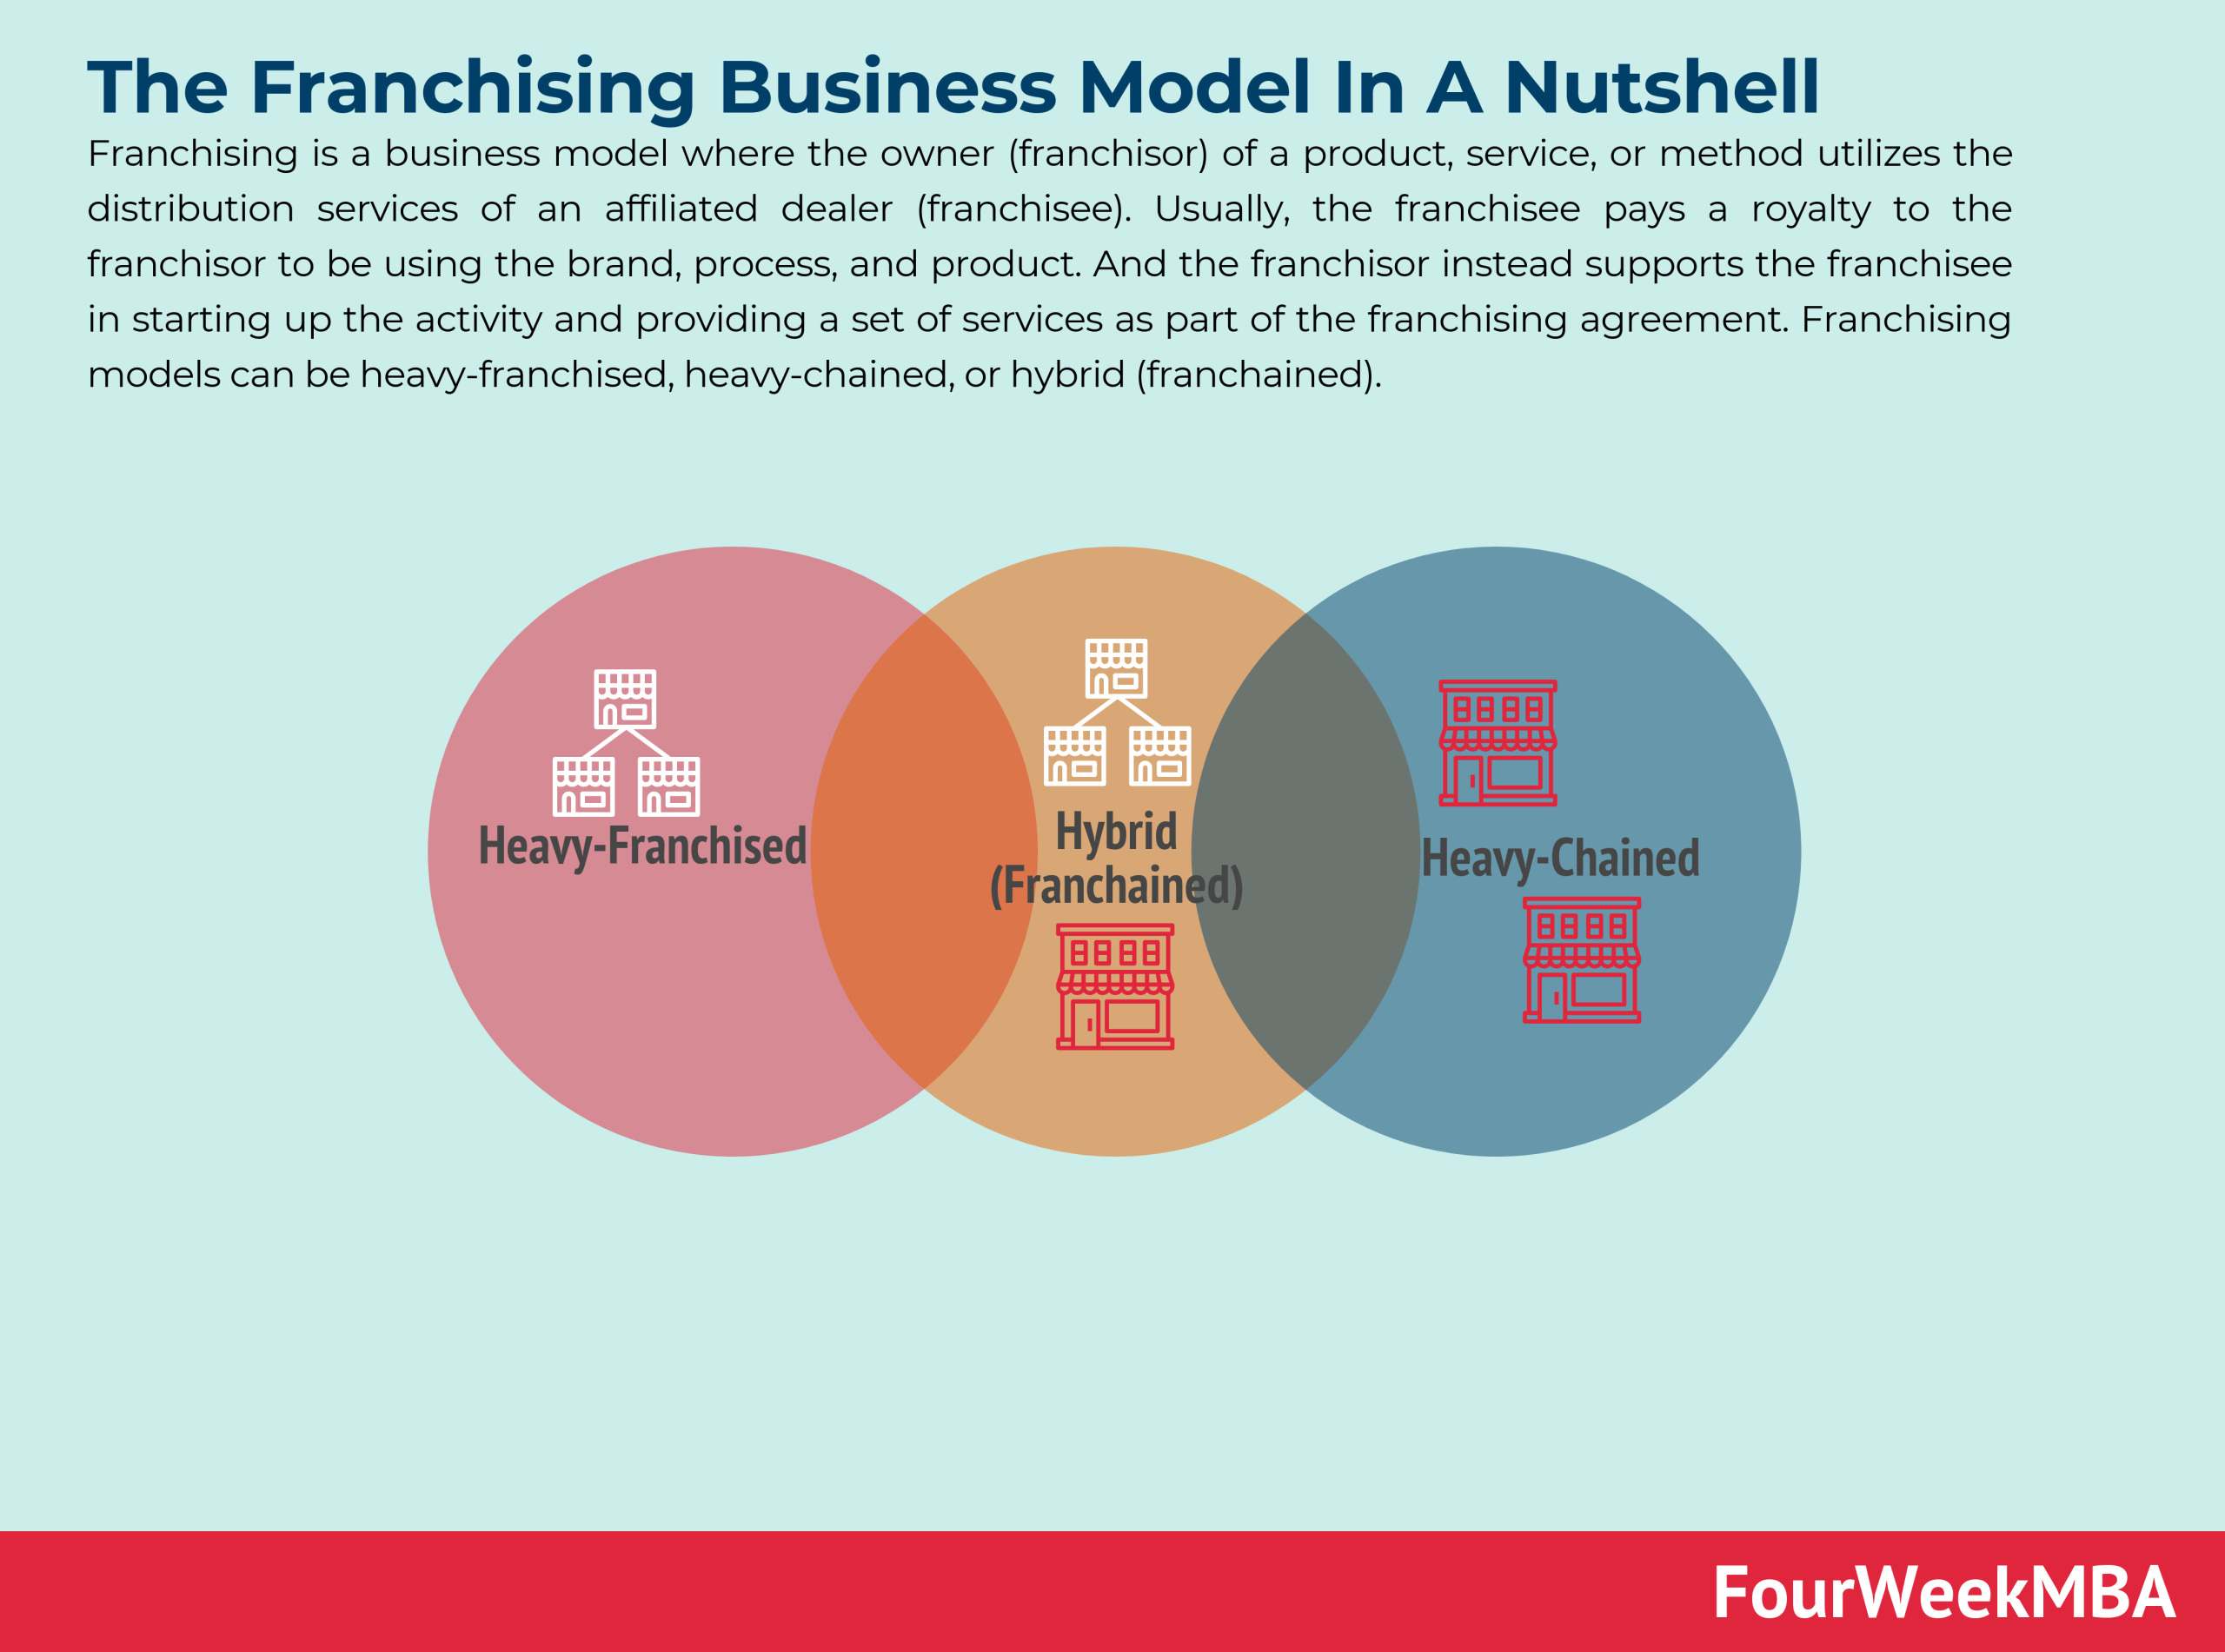

Slide 19
Razor and Blade Model: In this model, businesses sell a primary product at a low or subsidized price and generate recurring revenue from sales of complementary or consumable products or services. The initial product serves as a "razor" to drive adoption, while subsequent sales act as the "blade" to generate ongoing revenue. Examples include printers and ink cartridges, gaming consoles and games, and mobile devices and apps.

Slide 20
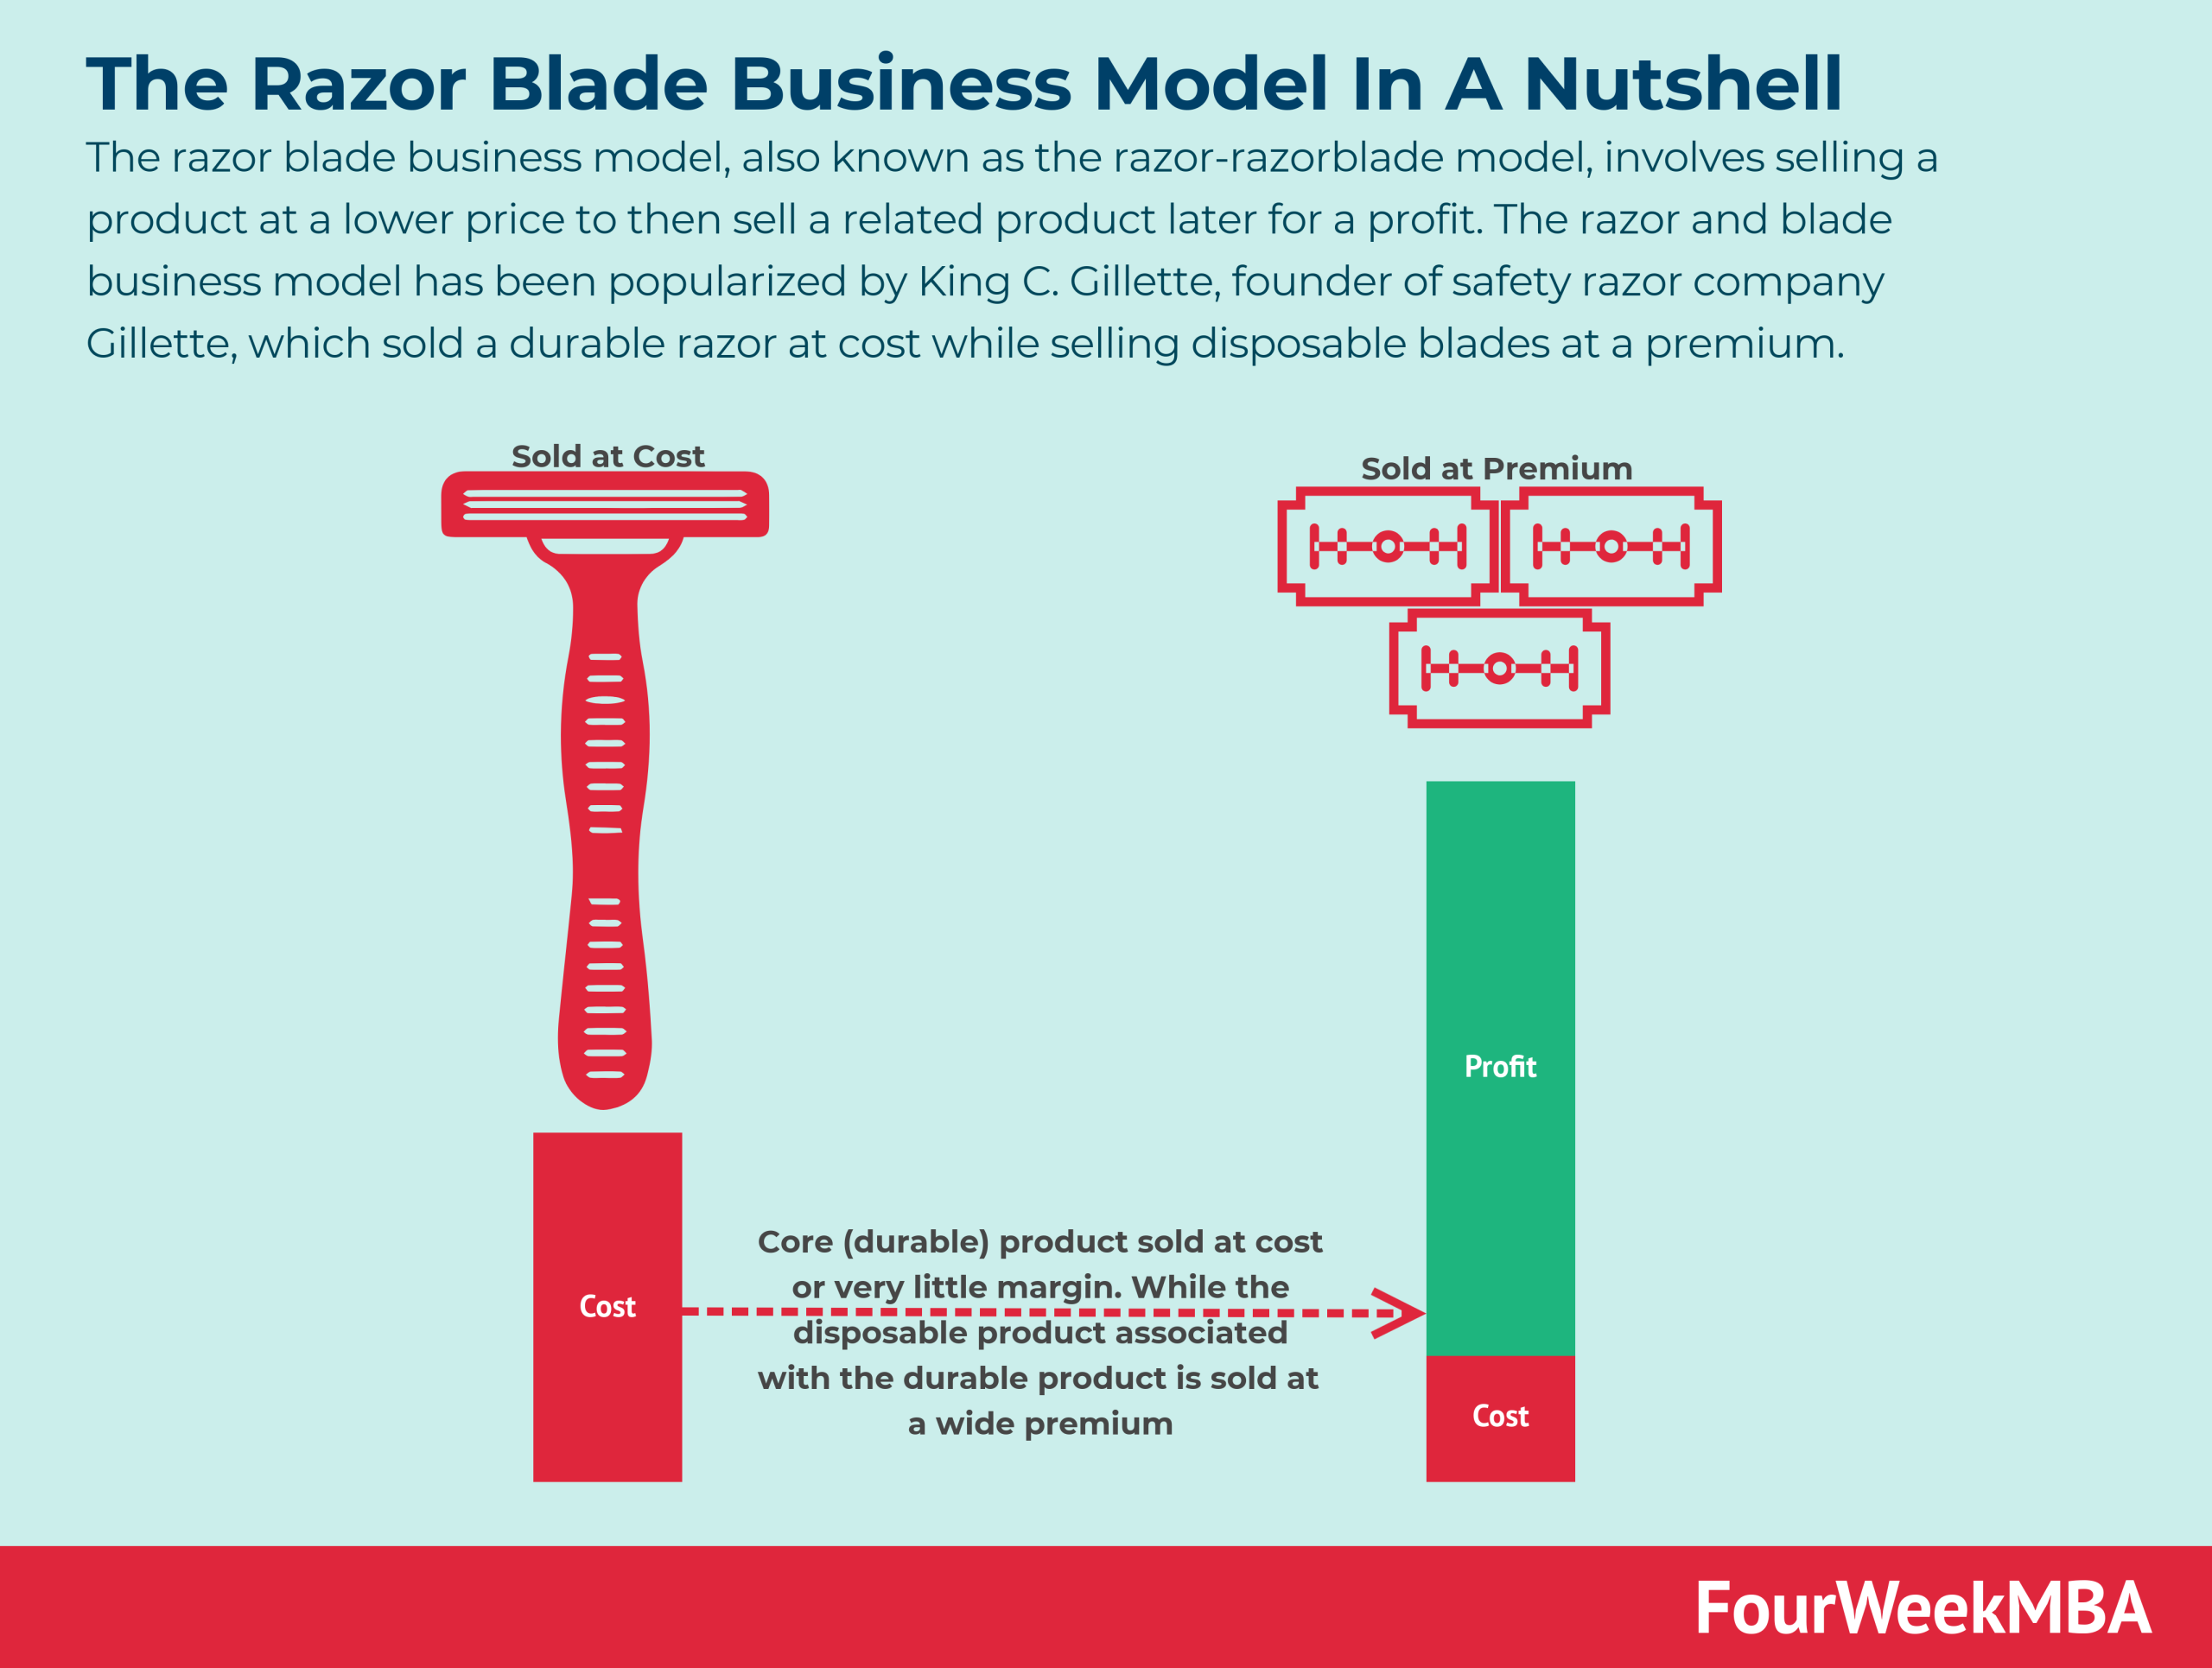

Slide 21
These business models provide firms with different strategic options for generating revenue, delivering value to customers, and achieving sustainable competitive advantage in their respective industries. Depending on the nature of the business, target market, and competitive landscape, firms may adopt one or more of these models or develop hybrid models to suit their specific needs and objectives

Slide 22
Questions?

